Slide 1
A Better Connected World

Slide 2
Huawei: A private, independent company wholly-owned by its employees
Revenue
(Year 2015)
62.9B USD
R&D Invest.
2015: 9.2B USD
Next 5 years:
10B- 20B/Year
170,000+
Employees
80,000+
R&D
Rank 129th
in Fortune
Global 500
(2016)

Slide 3
ICT is a major and high-potential sector of the economy
High-growth
High-value-added
Highly competitive
ICT as a proportion of GDP: 6.4 % to 9%
The global ICT industry is growing at 2.6%, faster than the 2.4% average growth rate for world GDP
A 20% increase in ICT investment can accelerate GDP growth by 1%.
Every dollar invested in ICT infrastructure generates additional value of US$1.4.
Revenue CAGR and profit CAGR of Fortune Global 500 companies in 2015: –11.5% and –11.3%.
Profit CAGR for Siemens, Bosch, and DT: 48%, 143%, 192%

Slide 4
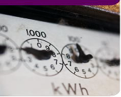
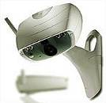
ICT boosts efficiency and drives industry transformation
Helping other industries go digital
Boosting transaction efficiency and reducing transaction costs
By 2025
100 B connections
Sales revenue per CNY1 cost
(Unit: RMB)
49.6
39.6
44.9
Physical stores
Online retailing
11.7
12.6
12.5
2009
2010
2011
55 billion connections will be created in sectors such as smart manufacturing, smart cities, and public services.
Source: National Statistics Bureau, Financial Statements of Yahoo

Slide 5
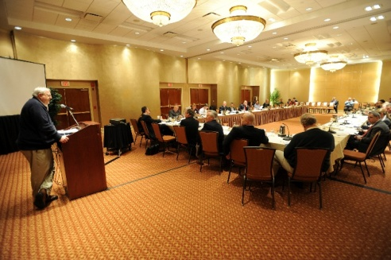
ICT is enabling a better, more efficient government
Public services
Public management
Public participation
Inclusive, efficient, and high-quality
Open, transparent,
responsible, and effective
Enhanced participation and greater trust

Slide 6
Developing a ready pool of tech professionals to support industry development
Develop leading tech development skills
Fully develop the ecosystem
Improving basic STEM education
Strengthening cooperation between industries and research institutions to nurture outstanding researchers with strong innovation capabilities; developing and supporting scientists
Providing funds, subsidies, and rewards
Supporting businesses to employ and develop technology professionals
Creating a favorable soft environment for workforce development
Top
Experts
Leading academic
figures
Key professionals
Basic talent pool
Projects/ Programmes | Description
Erasmus+ | Supporting education, training, youth and sport in Europe by provide opportunities for over 4 million Europeans to study, train gain experience, and volunteers abroad. Budget: €14.7 billion
Creative Europe | Supporting the culture and audiovisual sectors by financing hundreds of programmes in support of artists, actors, and musicians. Budgets: €1.46 billion
Marie Skłodowska-Curie actions | Research Fellowship Programme Supporting the career development and training of researchers worldwide
Europe
2020

Slide 7
Huawei in Europe: A collaborative industry contributor
2 regional offices, 44 subsidiaries
10,000+ employees
1,600 R&D engineers
Local investment: US$4bn
Technical cooperation: EUR75m
Seeds for the Future program participants: 500+ top university students from 23 countries
Another 2,000 European university students are expected to go on study trips to China over the next five years
210 technical cooperation contracts; member of 8 EU-led "Horizon 2020" projects; partner of over 100 European universities and research institutes

Slide 8
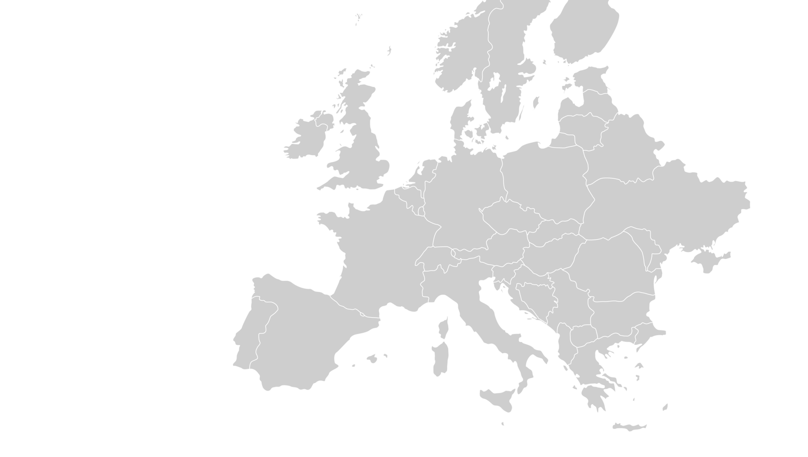
Huawei in Europe
customer training centers
technical assistance
centers
network O&M centers
7
2
6
2
logistics centers
2
EMS vendors
1
spare parts center
86
spare parts
warehouses
24
country-level warehouses

Slide 9
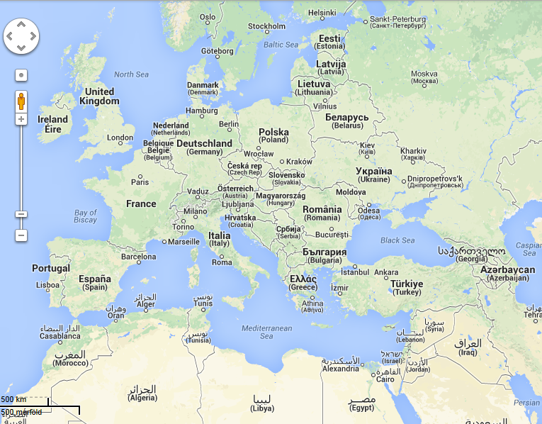
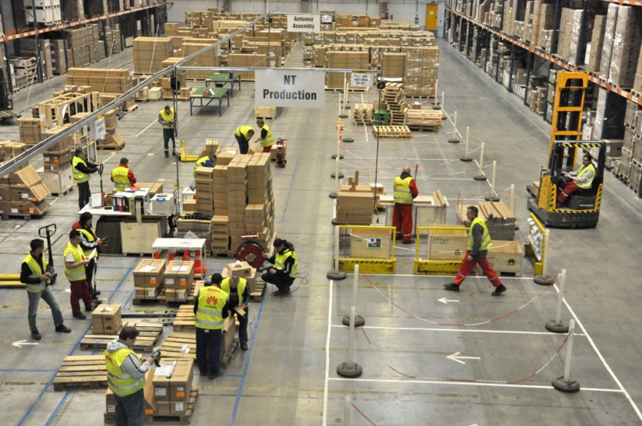
Huawei's European Logistics Center in Hungary
Serves 50 countries
Huawei's second largest global logistics center
Assembles and produces communications gear, such as wireless, access network, optical transmission, microwave transmission, servers, and storage products.
Major partners

Slide 10
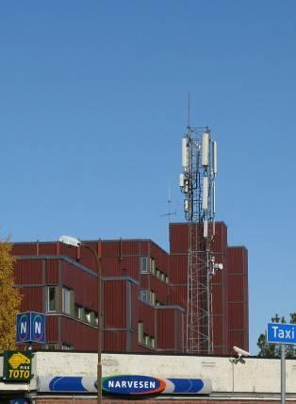
Helping European operators maintain their leadership
Huawei has worked closely with European operators during the end-to-end process and commercialized its new products first in Europe, driving Europe's development of cutting-edge technologies.
In 2004, Huawei launched the industry’s first distributed base station and firstly deployed it in Europe.
In December 2009, Huawei deployed the world's first LTE network for TeliaSonera.
In October 2010, many operators in Sweden and Austria were the first to commercially use Huawei's industry leading E398 data card that supports LTE, 3G, and 2G.
In May 2011, Huawei deployed the world's first LTE DD800 network using the SingleRAN LTE solution for Vodafone.
In September 2011, Huawei deployed the world's first LTE TDD/FDD FMC network for Polish operator Aero2.
In October 2012, Huawei launched the world's first second-generation E-band microwave solution which was first commercially deployed in Europe.
In October 2013, Huawei and BT successfully launched the world's first G.fast trial, bringing copper access into the Gigaband era.
In November 2014, the University of Surrey unveiled the world's first 5G testbed at its 5G Innovation Centre (5GIC). As a founding member of 5GIC, Huawei played a key role.
TeliaSonera's LTE base station

Slide 11
Helping SMEs grow
SME | Value Created | Before | After
OFG is a telecommunication services company based in Spain and became a partner of Huawei in April 2012. | More employees | 152 | 245
 | Revenue growth | EUR8.1m | EUR13.89m (42% from Huawei)
 | Capability improved | Providing consulting services only | -Expanded into engineering services and specialized services. -Employees' skills have improved thanks to Huawei's onsite support and training.
Greenwoods Communications is a leading independent supplier of communications infrastructure in the UK and has been a partner of Huawei since 2006. | More employees | Less than 200 | More than 500
 | Revenue growth | GBP26m | GBP40m (40% from Huawei)
 | Capability improved | Providing raw materials only | -Expanded into fixed network engineering services and improved employees' expertise.
CIP CIP is a UK-based technology company specialized in researching optical chips and photonics and was acquired by Huawei in January 2012. | More investment; enabling industry-level innovation | Annual investment: US$6m | -Annual investment: US$10m+ -CIP's technologies have been used in many Huawei products which create about US$3.6bn in sales each year. -After the acquisition, CIP became Huawei's major photonics laboratory and remains an active member of the EU's research community. The CIP team is now involved in five EU sponsored development programs.

Slide 12
Continuing to increase R&D investment in Europe
Stockholm
Wireless systems
Helsinki
Terminal OS, European
Security Competence Center
Gothenburg
Wireless basestations
Lund
Terminal chipset design
Cambridge
IoT, wireless chip
Gent
Silicon Photonics Technology
Dublin & Cork
OSS &BSS
Berlin
Standard patent
Louvain-la-Neuve
Application software
architecture
Ipswich
Optoelectronics
Bristol
CPU Core
Nuremberg
Energy technology
Paris
Standard patent, algorithm, aesthetics
Leuven
RFIC
Munich
5G, hardware and engineering, Engineering Test Center, cyber security
Nice
Graphic chip design
Milan
Microwave
18 R&D centers in 8 countries
Working with 200+ researchers and experts and 150+ universities;
funding 80+ R&D projects

Slide 13
Huawei Innovation Research Program (HIRP)
– In Europe, For Europe
High-level academic
achievements
Core patents
Innovative
Solutions
& Products
Collaborate with more than 300 research institutes and 900 companies distributed in more than 20 nations.
Almost cover all the QS100 universities all over the world
More than 100 IEEE/ACM fellows and national academicians
More than 50 national key labs and 2 Nobel Prize Winner teams
368 top labs in key tech-fields has been pinpointed, more than 50% of which have collaborated with Huawei.
Overview
Transform S&T to productivity
Testing environment
Challenges
Requirements
Innovative idea
Innovative sparks
Industry Challenges
Industry support
Huawei
HIRP
1billion+ USD
Academic contribution
Power of
knowledge
Australia
Since HIRP was launched in Europe in 2010, we have partnered with 120 universities and research and consulting institutes, including: The University of Oxford, University of Cambridge, University of Manchester, Technical University of Munich, and Fraunhofer.
Funded 107 research projects in 2015, covering graphene, wireless, optical, cloud computing, media technologies, and cyber security.
Continual investment
HIRPOPEN
Global R&D talents and teams
FLAGSHIP
Global distinguished scholars
All-win by broad cooperation

Slide 14
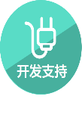
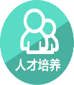
Huawei plans to invest US$1 billion to support global developers; the next focus of the plan will be European developers
Developer Enablement Plan:
US$1bn in five years
China -> Europe -> Global
Huawei plans to invest more than EUR75m in supporting European developers by 2020. As part of the plan, we will build 3 Open Labs in the UK, Germany, and Italy and support 100,000+ developers.
Invested US$300m in the past year
Registered developers rose from 2,000 to 25,000
Hatched 230 solutions with developers and delivered 500 projects
Helped developers save about US$50m in innovation costs through Open Labs
Created revenue growth of about US$300m for developers

Slide 15
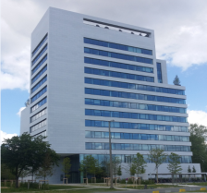
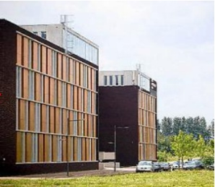
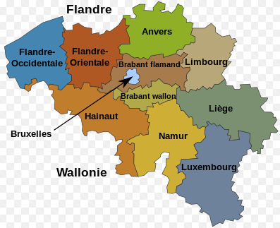
Continuing to R&D investment in Belgium
Joint venture
R & D Center: The Belgian Institute has two R & D offices in Leuven and Ghent; Cooperation: Nearly 3 years, technical cooperation projects 20 +, cooperation funding of about 25 million Euros;
2014, Huawei (Haisi) and Belgium's leading chip research and development company IMEC signed a strategic cooperation agreement. IMEC in Europe and even the world are chip leader in the field. 2015, During the visit of the Belgian King, IMEC, Huawei, SMIC, Qualcomm set up Joint Venture to develop the next generation of CMOS technology. 2016, R & D costs + technical cooperation costs, for the first time exceeded 20 million euros. In recent years, continuous research and development staff, Dr., consultants cooperation.
Ghent Office
Leuven Office
Innovation Center

Slide 16
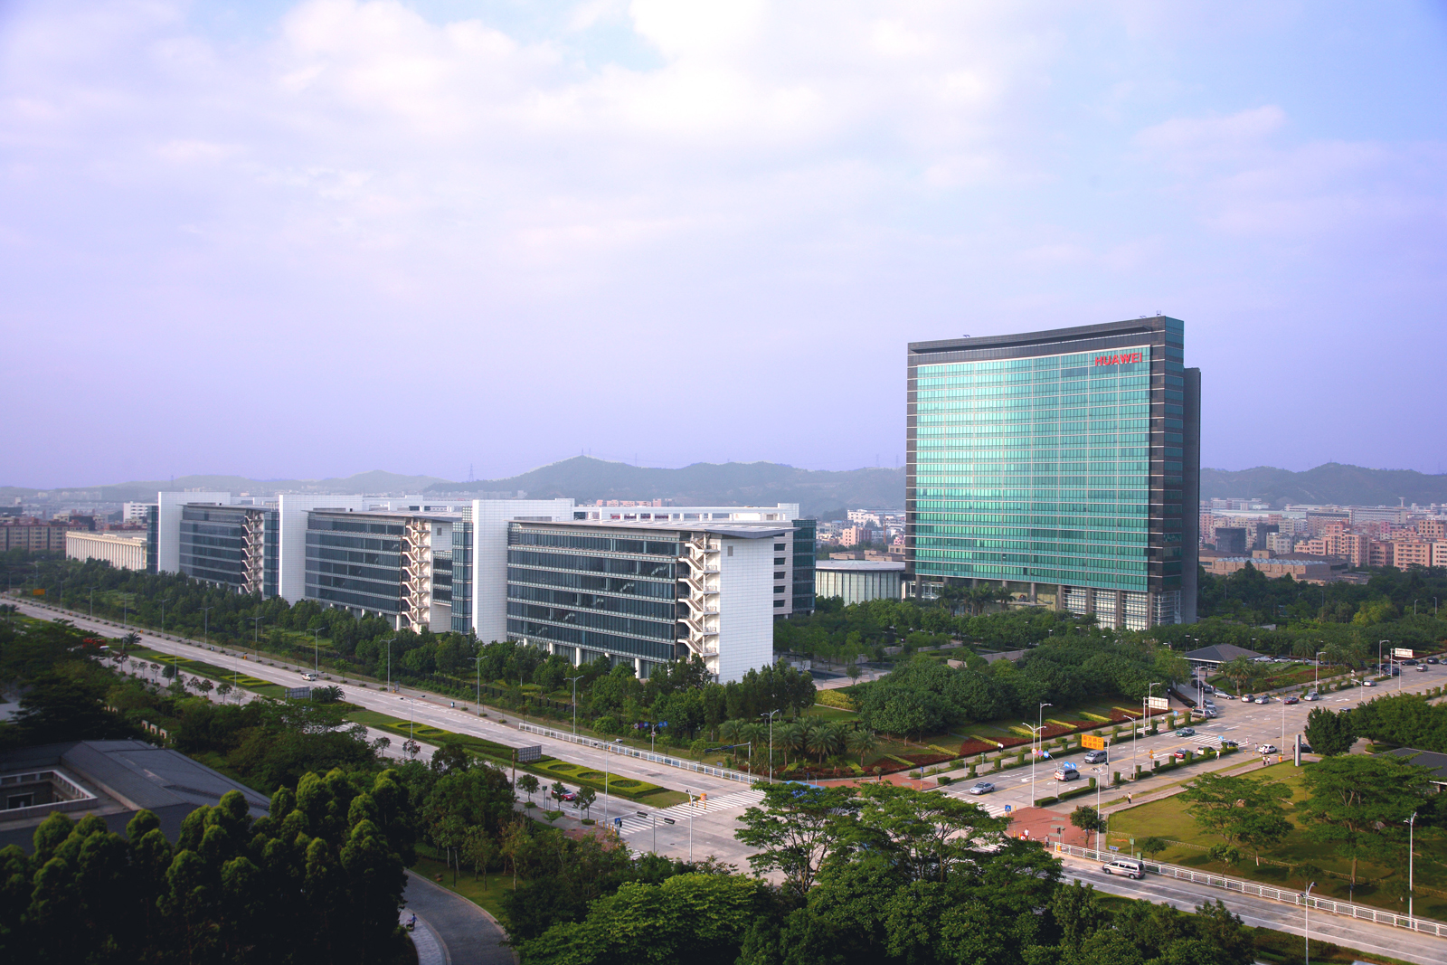
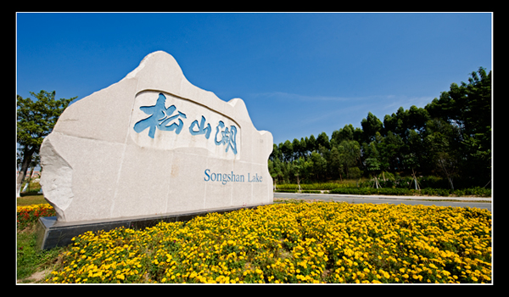
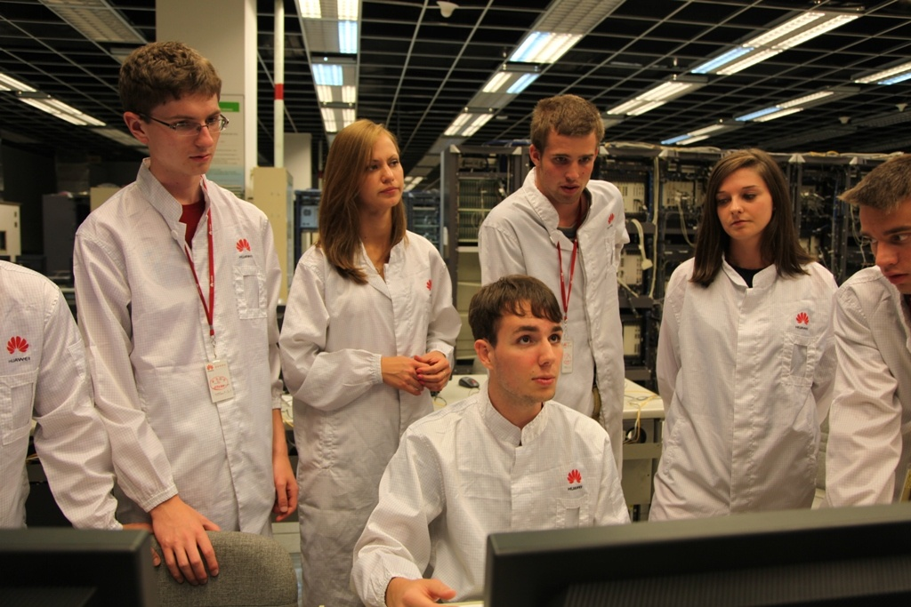
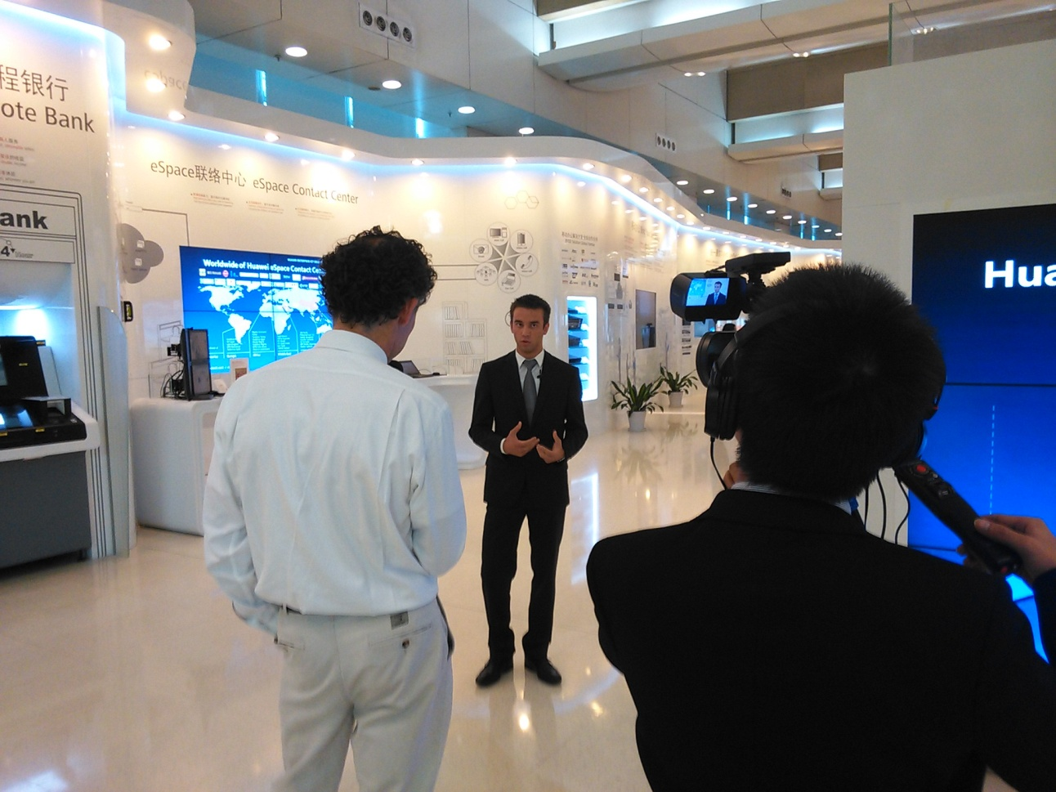
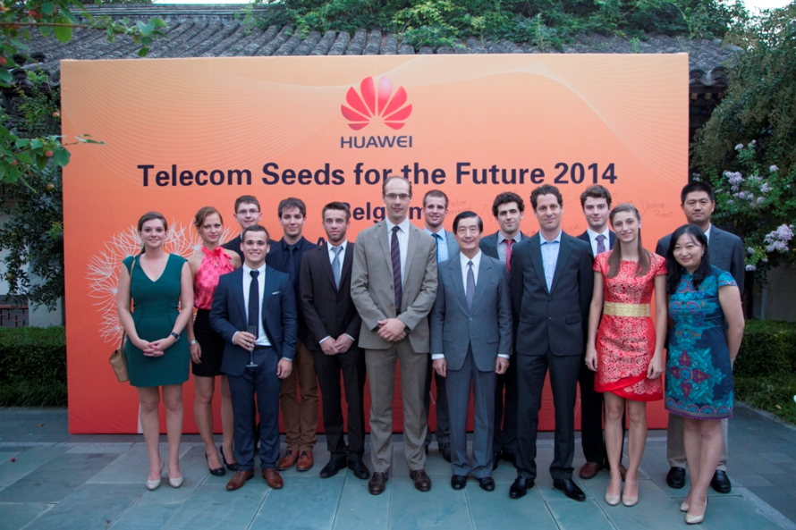
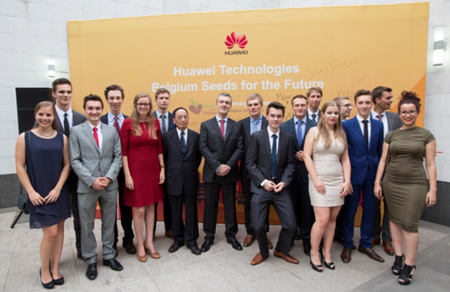
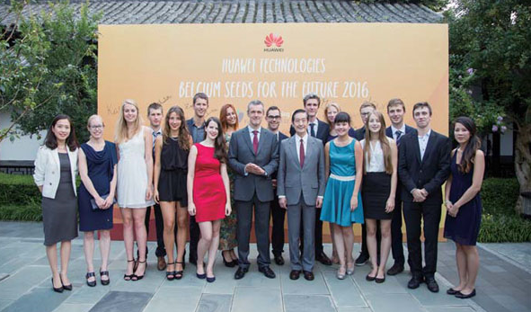
ICT Seeds For the Future: Training ICT leaders of next generation, help to nurture young and talented people
Huawei promotes the development of ICT education in Europe and strengthening the global experience of youth.
“ICT seeds for the future” program sends young people to China and training in digital education and ICT skills.
2014, Huawei launched the program with the UGent (University of Gent);
2015, Huawei launched the program with the KUL, UCL, UGent and VUB;
2016, Huawei launched the program with the KUL, UCL, UGent, Ulg and VUB;

Slide 17
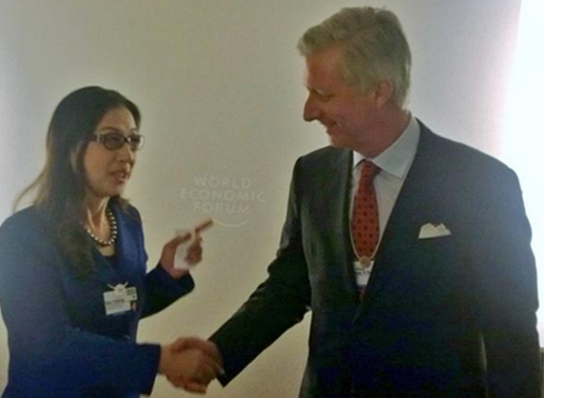
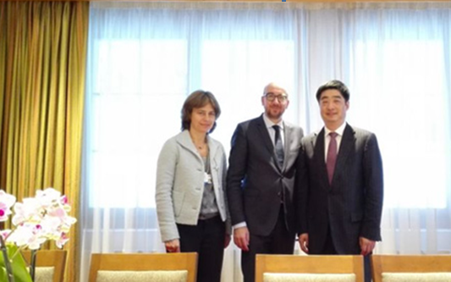
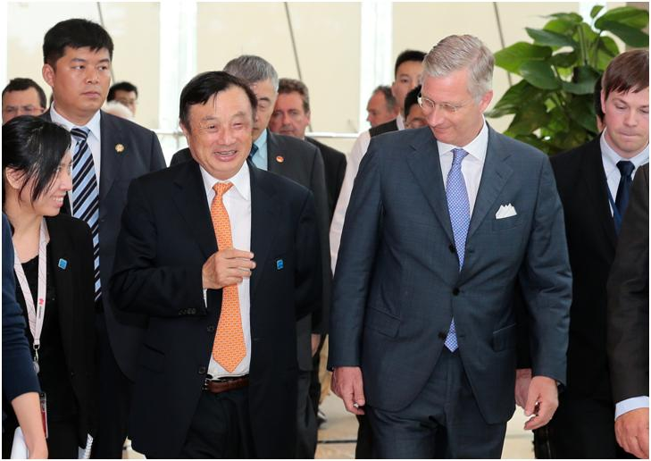
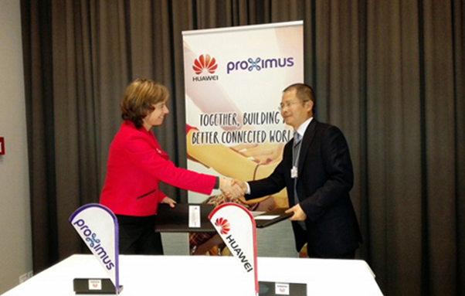
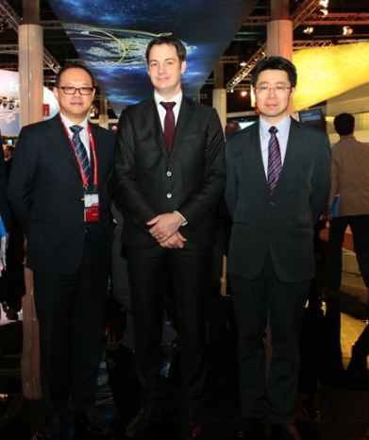
Historical Communication
22nd Jan 2015, the King Mr. Philippe met Huawei Madam Sun
22nd Jan 2015, PM Mr. Charles Michel met Huawei Mr. Huhoukun
27th Jun 2015, the King Mr. Philippe met Huawei Ren Zhengfei
21st Jan 2015, Proximus and Huawei announced the establishment of strategic cooperative partnership
4th Mar2015, Deputy PM Mr. Alexander De Croo discussed the ICT development and innovation

Slide 18
Thank you !
Copyright©2014 Huawei Technologies Co., Ltd. All Rights Reserved.
The information in this document may contain predictive statements including, without limitation, statements regarding the future financial and operating results, future product portfolio, new technology, etc. There are a number of factors that could cause actual results and developments to differ materially from those expressed or implied in the predictive statements. Therefore, such information is provided for reference purpose only and constitutes neither an offer nor an acceptance. Huawei may change the information at any time without notice.

